Slide 1
Chapter 3
Financial Statements Analysis

Slide 2
3.1 Financial Statements Analysis
Common-Size Balance Sheets
  Compute all accounts as a percent of total assets
Common-Size Income Statements
  Compute all line items as a percent of sales
Standardized statements make it easier to compare financial information, particularly as the company grows.
They are also useful for comparing companies of different sizes, particularly within the same industry.

Slide 3
3.2 Ratio Analysis
Ratios also allow for better comparison through time or between companies.
As we look at each ratio, ask yourself:
  How is the ratio computed?
  What is the ratio trying to measure and why?
  What is the unit of measurement?
  What does the value indicate?
  How can we improve the company’s ratio?

Slide 4
Categories of Financial Ratios
Short-term solvency or liquidity ratios
Long-term solvency or financial leverage ratios
Asset management or turnover ratios
Profitability ratios
Market value ratios
Notes:
The ratios in the following slides will be computed using the 2012 information from the Balance Sheet (Table 3.1) and Income Statement (Table 3.4) given in the text.

Slide 5
PRUFROCK CORPORATION
33 million shares outstanding
EPS = Earnings per Share
EBIT = Earnings Before Interest and Taxes
EBITDA = Earnings Before Interest, Taxes, Depreciation and Amortization
  A proxy for “Free Cash Flow” which we will define (and use) later

Slide 6
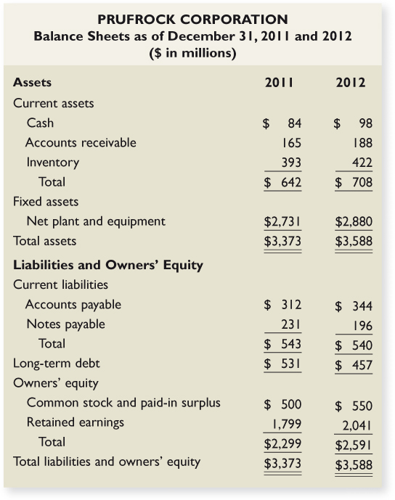

Slide 7
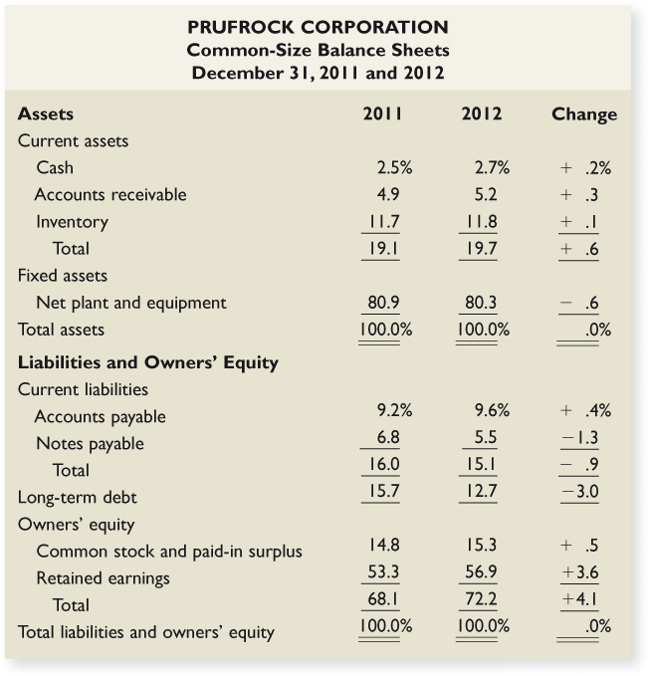

Slide 8
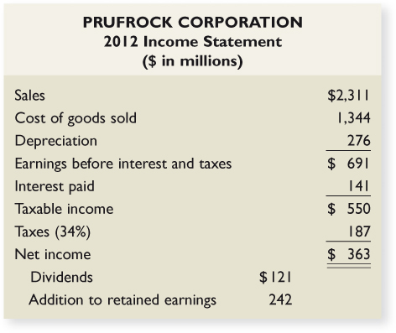

Slide 9
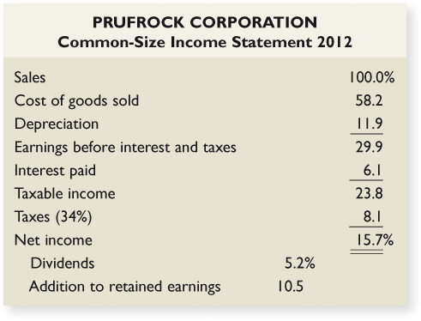

Slide 10
Computing Liquidity Ratios
Current Ratio = CA / CL
  708 / 540 = 1.31 times
Quick Ratio = (CA – Inventory) / CL
  (708 - 422) / 540 = .53 times
Cash Ratio = Cash / CL
  98 / 540 = .18 times
Notes:
The firm is able to cover current liabilities with it’s current assets by a factor of 1.3 to 1. The ratio should be compared to the industry – it’s possible that this industry has a substantial amount of cash flow and that they can meet their current liabilities out of cash flow instead of relying solely on the liquidation of current assets that are on the books.
The quick ratio is quite a bit lower than the current ratio, so inventory seems to be an important component of current assets.
This company carries a low cash balance. This may be an indication that they are aggressively investing in assets that will provide higher returns. We need to make sure that we have enough cash to meet our obligations, but too much cash reduces the return earned by the company.

Slide 11
Computing Leverage Ratios
Total Debt Ratio = (TA – TE) / TA
  (3588 - 2591) / 3588 = 28%
Debt/Equity = TD / TE
  (3588 – 2591) / 2591 = 38.5%
Equity Multiplier = TA / TE = 1 + D/E
  1 + .385 = 1.385
Notes:
Note that these are often called solvency ratios.
TE = total equity, and TA = total assets. The numerator in the total debt ratio could also be found by adding all of the current and long-term liabilities.
The firm finances approximately 28% of its assets with debt.
Another way to compute the D/E ratio if you already have the total debt ratio:
D/E = Total debt ratio / (1 – total debt ratio) = .28 / .72 = .39
Note the rounding error as compared to the direct method applied in the slide.
The EM is one of the ratios that is used in the Du Pont Identity as a measure of the firm’s financial leverage.

Slide 12
Computing Coverage Ratios
Times Interest Earned = EBIT / Interest
  691 / 141 = 4.9 times
Cash Coverage = (EBIT + Depreciation + Amortization) / Interest
  (691 + 276) / 141 = 6.9 times
Notes:
Remember that depreciation (and amortization) is a non-cash deduction. A better indication of a firm’s ability to meet interest payments may be to add back the depreciation and amortization to get an estimate of cash flow before taxes.
You can also calculate a type of inverse value as follows:
Interest Bearing Debt / EBITDA = (196 + 457) / 967 = .68
Values less than one are indicative of a stable position.

Slide 13
Computing Inventory Ratios
Inventory Turnover = Cost of Goods Sold / Inventory
  1344 / 422 = 3.2 times
Days’ Sales in Inventory = 365 / Inventory Turnover
  365 / 3.2 = 114 days
Notes:
Inventory turnover can be computed using either ending inventory or average inventory when you have both beginning and ending figures. It is important to be consistent with whatever benchmark you are using to analyze the company’s strengths or weaknesses.
It is also important to consider seasonality in sales. If the balance sheet is prepared at a time when there is a large inventory build-up to meet seasonal demand, then the inventory turnover will be understated and you might believe that the company is not performing as well as it is. On the other hand, if the balance sheet is prepared when inventory has been drawn down due to seasonal sales, then the inventory turnover would be overstated and the company may appear to be doing better than it really is. Averages using annual data may not fix this problem. If a company has seasonal sales, you may want to look at quarterly averages to get a better indication of turnover.

Slide 14
Computing Receivables Ratios
Receivables Turnover = Sales / Accounts Receivable
  2311 / 188 = 12.3 times
Days’ Sales in Receivables = 365 / Receivables Turnover
  365 / 12.3 = 30 days
Notes:
Technically, the sales figure should be credit sales. This is often difficult to determine from the income statements provided in annual reports. If you use total sales instead of credit sales, you will overstate your turnover level. You need to recognize this bias when credit sales are unavailable, particularly if a large portion of the sales are cash sales.
As with inventory turnover, you can use either ending receivables or an average of beginning and ending.
You also run into the same seasonal issues as discussed with inventory.
Probably the best benchmark for days’ sales in receivables is the company’s credit terms. If the company offers a discount (1/10 net 30), then you would like to see days’ sales in receivables less than 30. If the company does not offer a discount (net 30), then you would like to see days’ sales in receivables close to the net terms. If days’ sales in receivables is substantially larger than the net terms, then you first need to look for biases, such as seasonality in sales. If this does not provide an explanation for the difference, then the company may need to take another look at its credit policy (who it grants credit to and its collection procedures).

Slide 15
Computing Total Asset Turnover
Total Asset Turnover = Sales / Total Assets
  2311 / 3588 = .64 times
  It is not unusual for TAT < 1, especially if a firm has a large amount of fixed assets.
Notes:
Having a TAT of less than one is not a problem for most firms. Fixed assets are expensive and are meant to provide sales over a long period of time. This is why the matching principle indicates that they should be depreciated instead of immediately expensed.
This is one of the ratios that will be used in the Du Pont identity.

Slide 16
Computing Profitability Measures
Profit Margin = Net Income / Sales
  363 / 2311 = 15.7%
Return on Assets (ROA) = Net Income / Total Assets
  363 / 3588 = 10.1%
Return on Equity (ROE) = Net Income / Total Equity
  363 / 2591 = 14.0%
EBITDA Margin = EBITDA / Sales
  967 / 2311 = 41.8%
Notes:
You can also compute the gross profit margin and the operating profit margin.
GPM = (Sales – COGS) / Sales
OPM = EBIT / Sales
Profit margin is one of the components of the Du Pont identity and is a measure of operating efficiency. It measures how well the firm controls the costs required to generate the revenues. It tells how much the firm earns for every dollar in sales. In the example, the firm earns almost $0.16 for each dollar in sales.
Note that the ROA and ROE are returns on accounting numbers. As such, they are not directly comparable with returns found in the marketplace. ROA is sometimes referred to as ROI (return on investment). As with many of the ratios, there are variations in how they can be computed. The most important thing is to make sure that you are computing them the same way as the benchmark you are using.
ROE will always be higher than ROA as long as the firm has debt (and ROA is positive). The greater the leverage, the larger the difference will be. ROE is often used as a measure of how well management is attaining the goal of owner wealth maximization. The Du Pont identity is used to identify factors that affect the ROE.

Slide 17
Computing Market Value Measures
Market Capitalization = $88 per share x 33 million shares = 2904 million
PE Ratio = Price per share / Earnings per share
  88 / 11 = 8 times
Market-to-book ratio = market value per share / book value per share
  88 / (2591 / 33) = 1.12 times
Enterprise Value (EV) = Market capitalization + Market value of interest bearing debt – cash
  2904 + (196 + 457) – 98 = 3465
EV Multiple = EV / EBITDA
  3465 / 967 = 3.6 times
Notes:
See Table 3.6, as well as the instructor’s manual (chapter 3 appendix), for a summary list of financial ratios.

Slide 18
Using Financial Statements
Ratios are not very helpful by themselves: they need to be compared to something
Time-Trend Analysis
  Used to see how the firm’s performance is changing through time
Peer Group Analysis
  Compare to similar companies or within industries
Notes:
SIC codes have been used many years to identify industries and allow for comparison with industry average ratios. The SIC codes are limited, however, and have not kept pace with a rapidly changing environment. Consequently, the North American Industry Classification System was introduced in 1997 to alleviate some of the problems with SIC codes.
Click on the web surfer to go the NAICS home page. It provides information on the change to the NAICS and conversion between SIC and NAICS codes.

Slide 19
3.3 The DuPont Identity
ROE = NI / TE
Multiply by 1 and then rearrange:
  ROE = (NI / TE) (TA / TA)
  ROE = (NI / TA) (TA / TE) = ROA * EM
Multiply by 1 again and then rearrange:
  ROE = (NI / TA) (TA / TE) (Sales / Sales)
  ROE = (NI / Sales) (Sales / TA) (TA / TE)
  ROE = PM * TAT * EM

Slide 20
Using the DuPont Identity
ROE = PM * TAT * EM
  Profit margin is a measure of the firm’s operating efficiency – how well it controls costs.
  Total asset turnover is a measure of the firm’s asset use efficiency – how well it manages its assets.
  Equity multiplier is a measure of the firm’s financial leverage.
Notes:
Improving our operating efficiency or our asset use efficiency will improve our return on equity. If the TAT is low compared to our benchmark, then we can break it down into more detail by looking at inventory turnover and receivables turnover. If those areas are strong, then we can look at fixed asset turnover and cash management.
We can also improve our ROE by increasing our leverage – up to a point. Debt affects a lot of other factors, including profit margin, so we have to be a little careful here. We want to make sure we have enough debt to utilize our interest tax credit effectively, but we don’t want to overdo it.

Slide 21
The DuPont Identity for Prufrock
ROA = 10.1% and EM = 1.39
  ROE = 10.1% * 1.385 = 14.0%
PM = 15.7% and TAT = 0.64
  ROE = 15.7% * 0.64 * 1.385 = 14.0%

